Slide 1
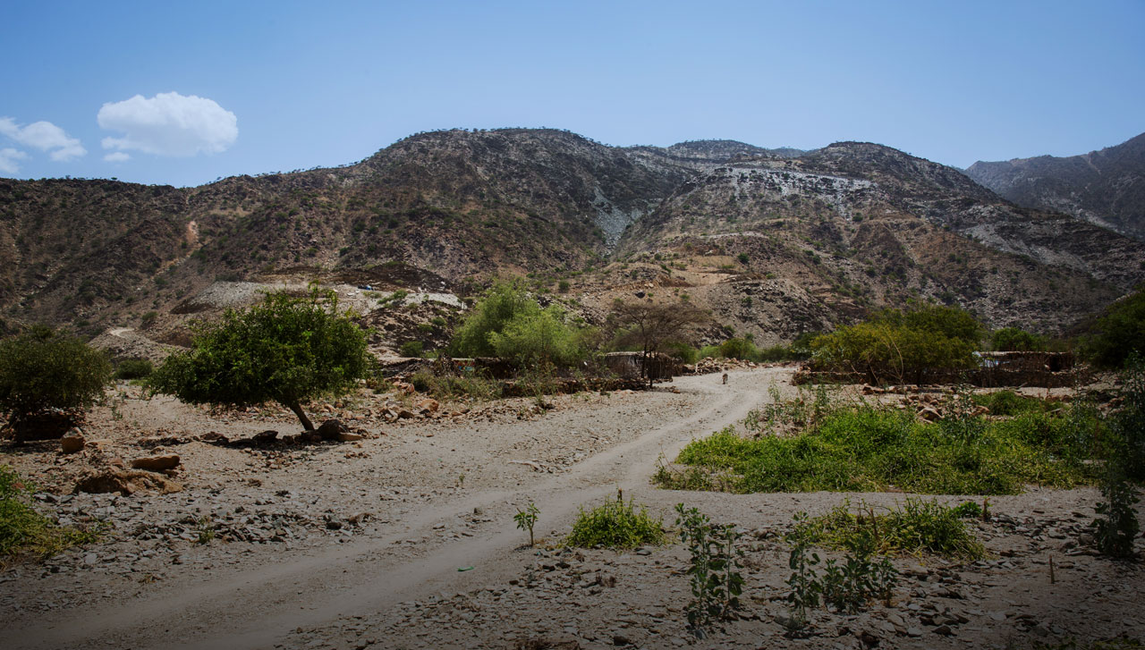

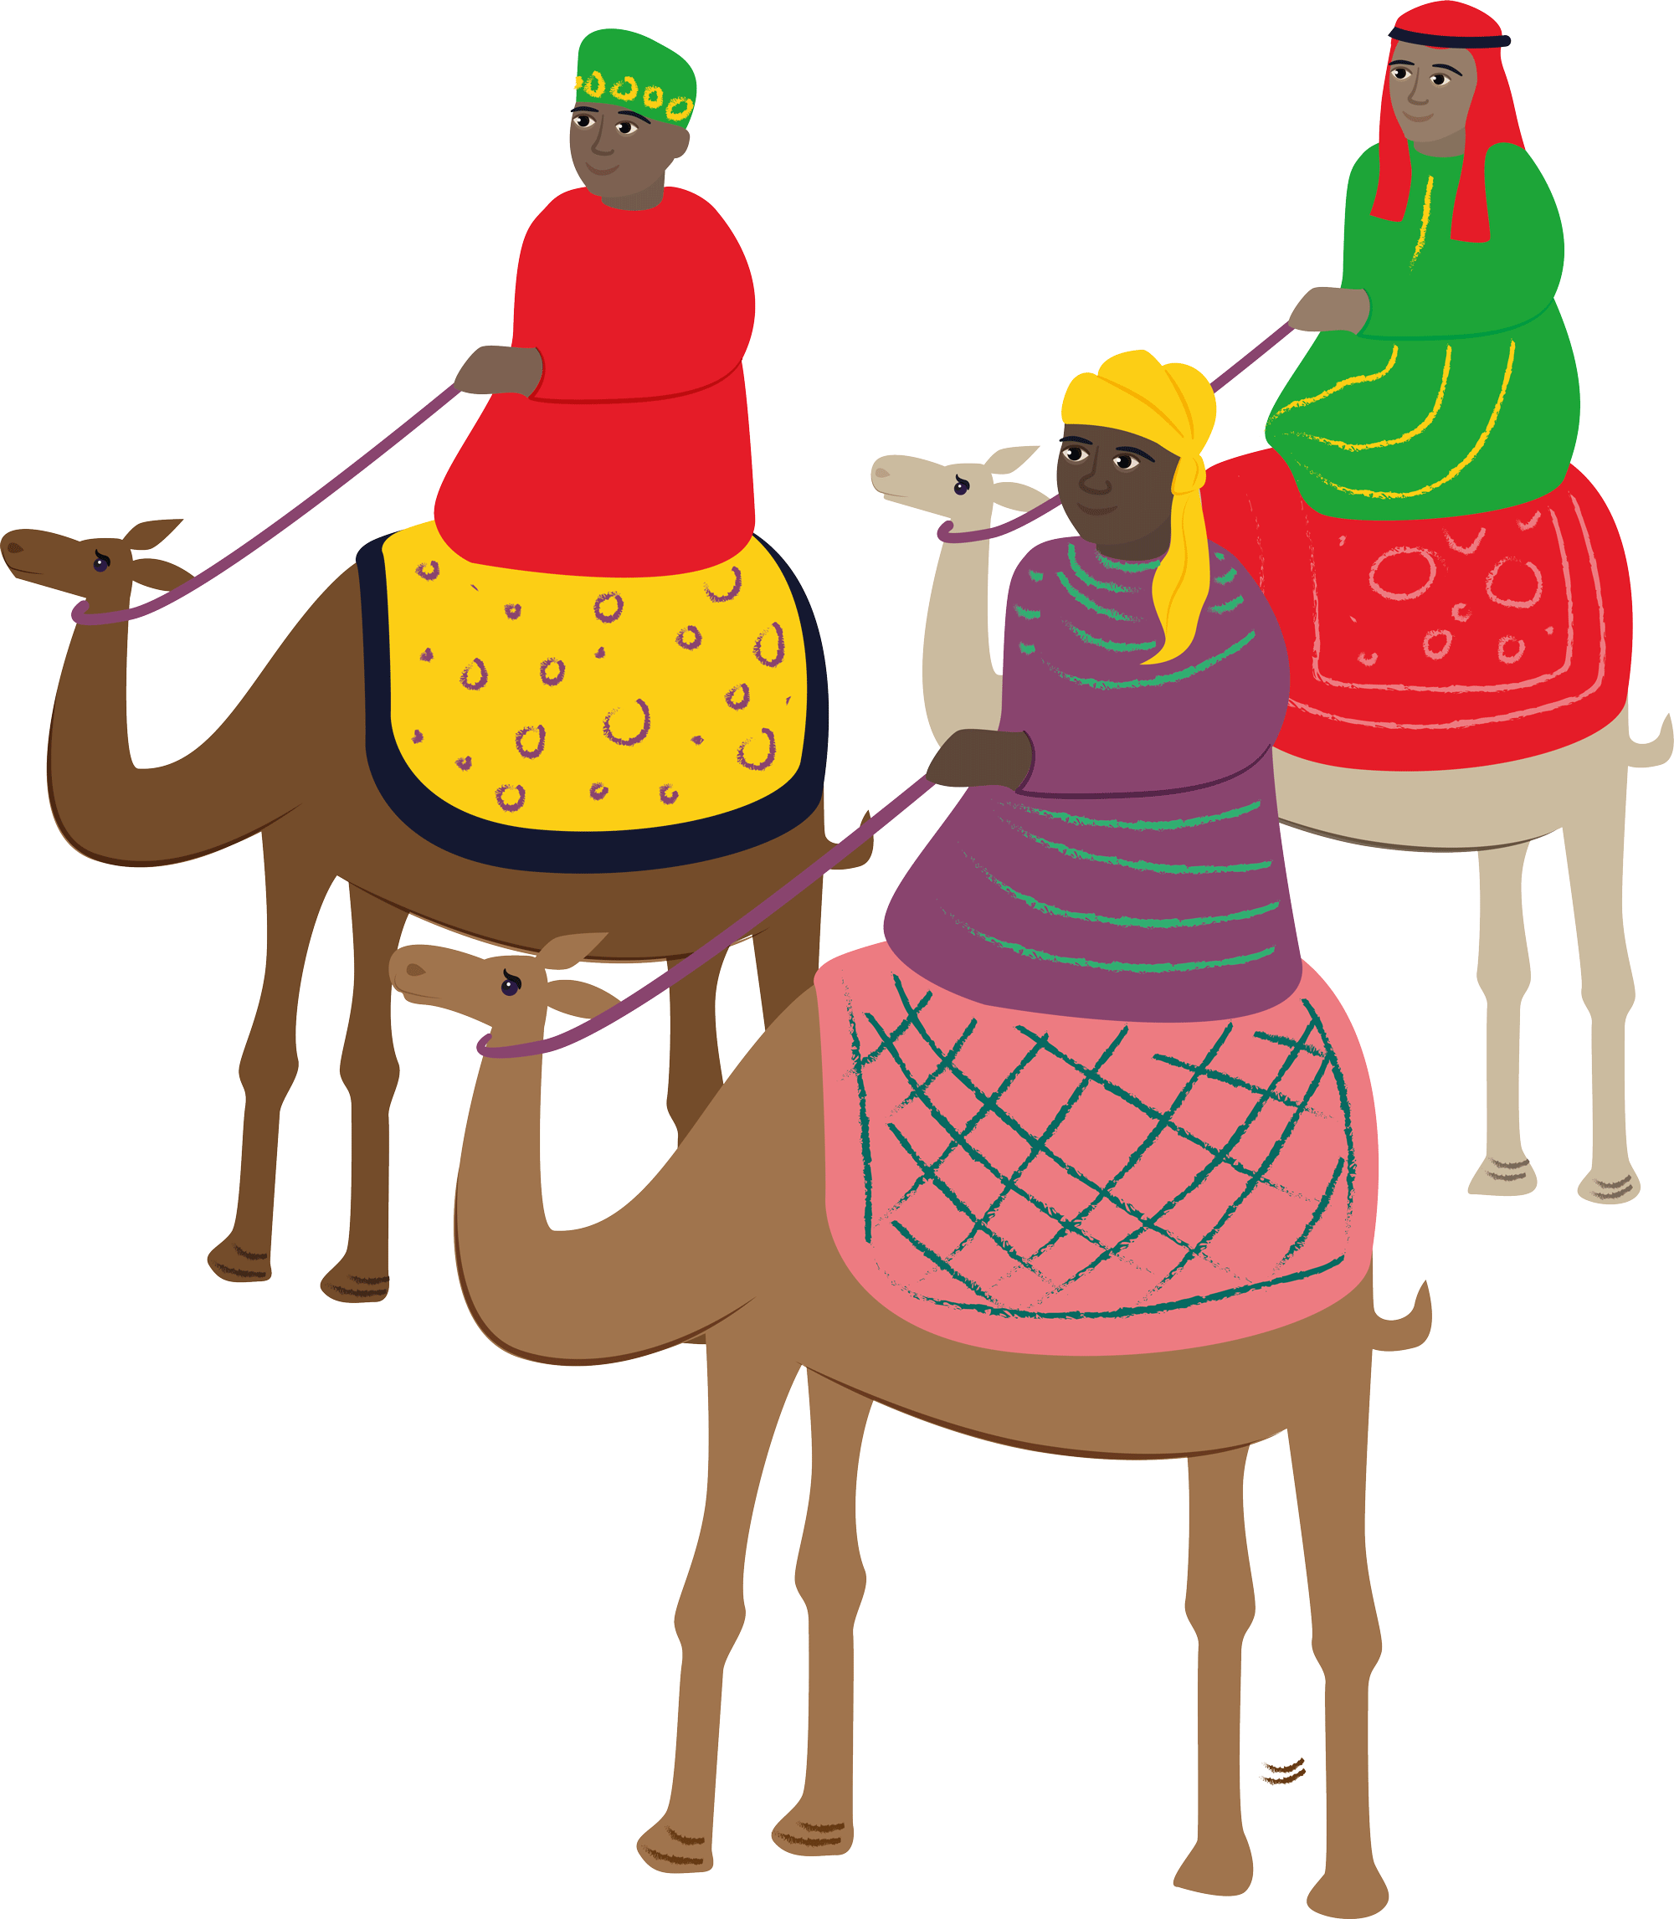
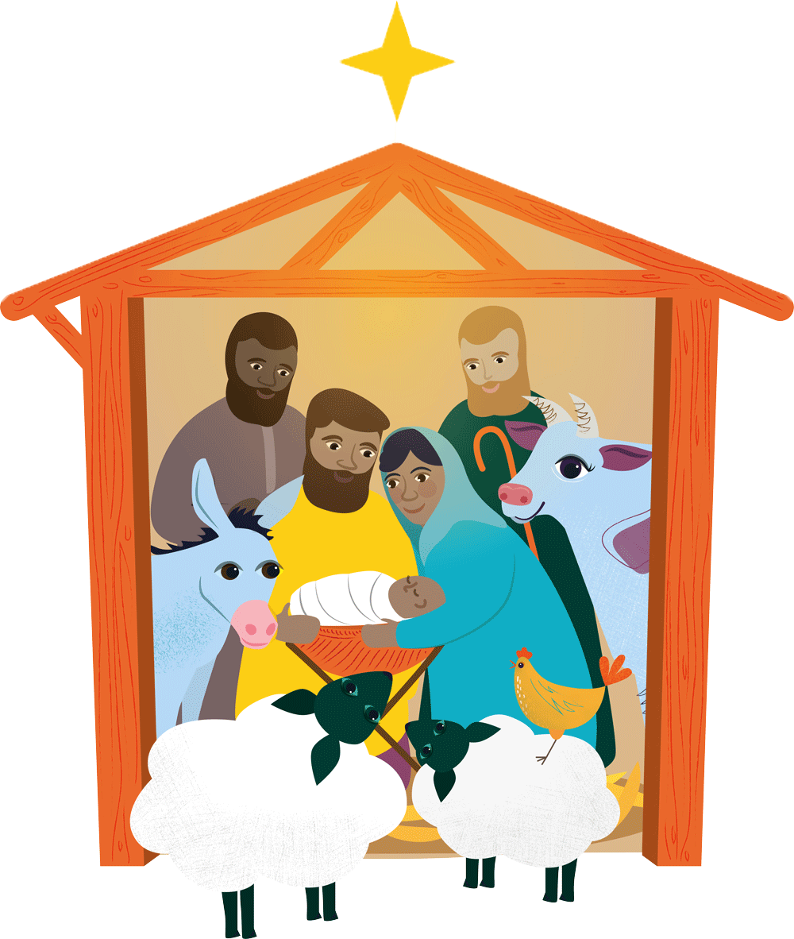
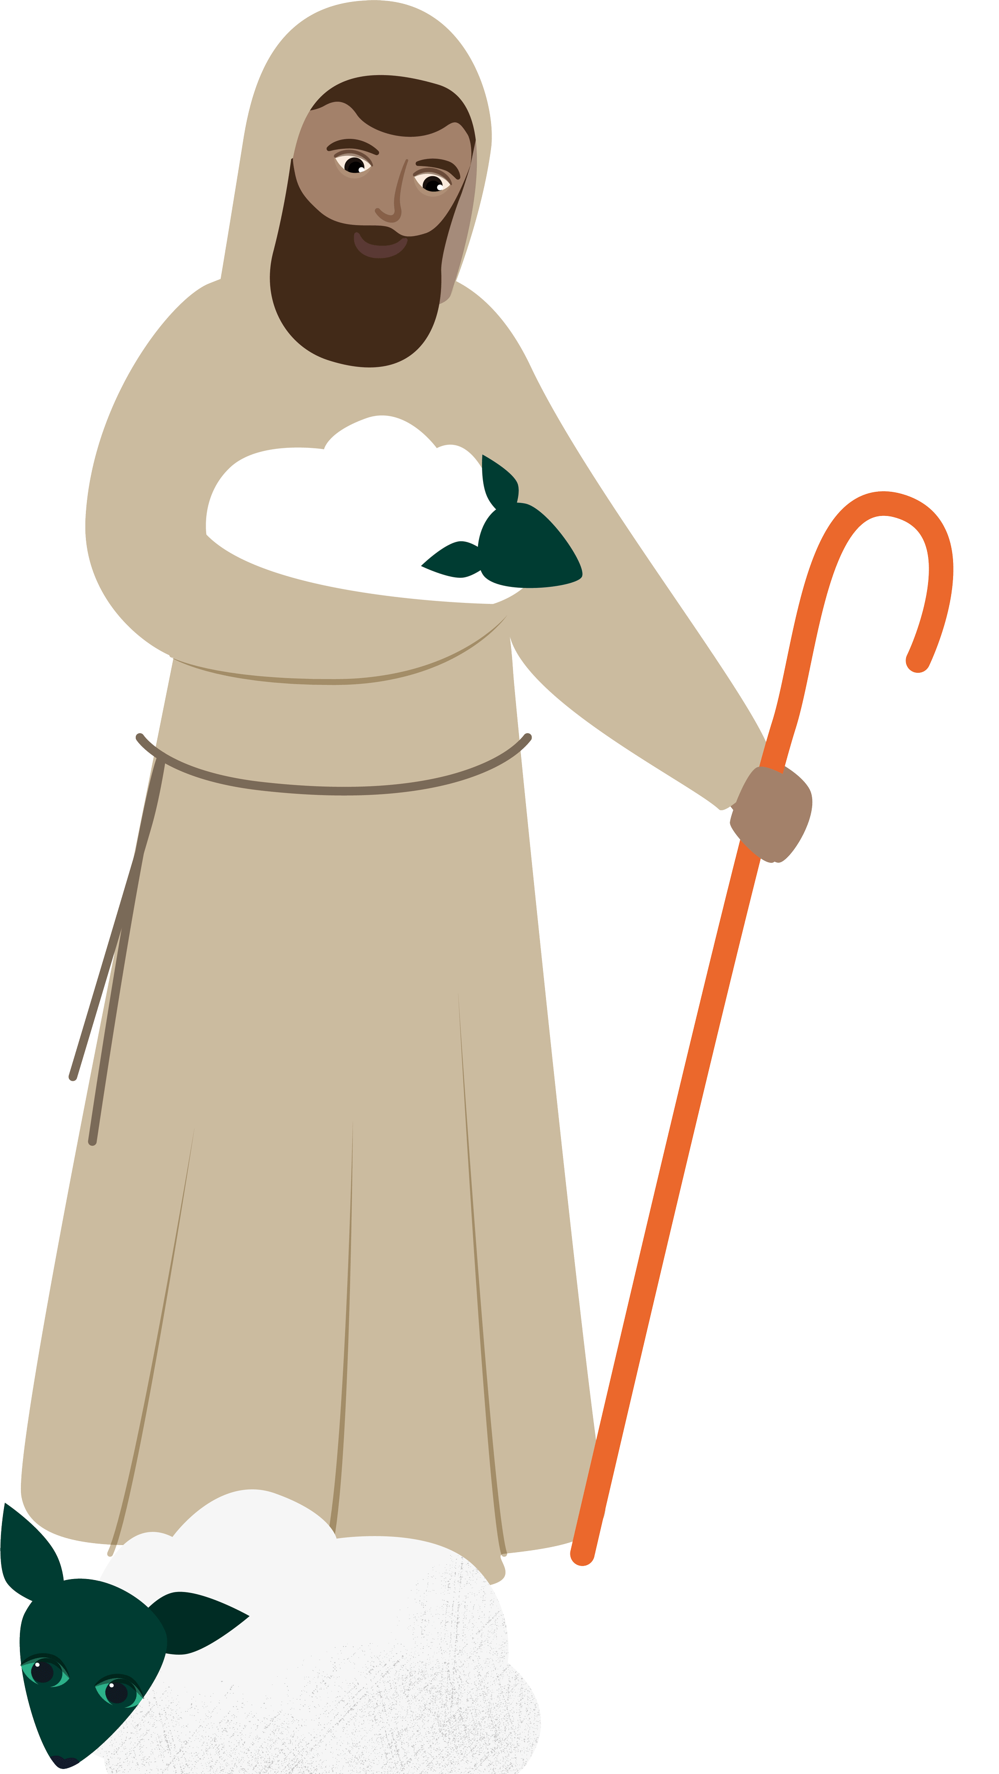
Advent calendar 2020
29
Nov
25
Dec
24
Dec
23
Dec
22
Dec
30
Nov
21
Dec
1
Dec
20
Dec
2
Dec
19
Dec
3
Dec
4
Dec
5
Dec
6
Dec
7
Dec
8
Dec
9
Dec
10
Dec
11
Dec
12
Dec
13
Dec
14
Dec
15
Dec
16
Dec
17
Dec
18
Dec
Notes:
Picture credit: Louise Norton/CAFOD

Slide 2
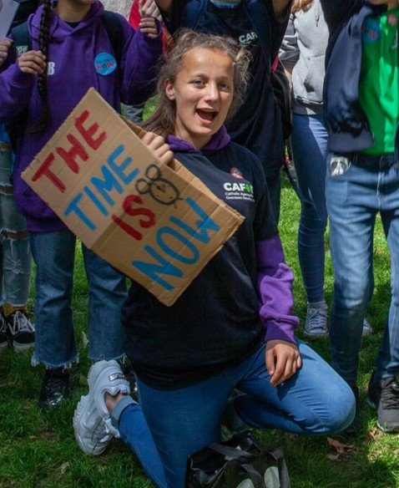
Sunday 29 November
First Sunday of Advent
“Stay awake, because you do not know when the master of the house is coming.”
Mark 13:35
  What are you waiting for?
  Waiting has been a big part of this year – lots of queues, waiting for school to reopen, and still waiting to be able to mix freely again.
  Advent is about waiting too.
  At the end of Advent we’re waiting to celebrate Christmas. Hurray!
  But the start of Advent is all about eagerly awaiting the Lord’s return at the end of time - staying awake!
Notes:
Picture credit: Jessie Keable-Elliott/CAFOD

Slide 3
  Like the servants in today’s reading, we can become sleepy as we await our Lord’s return, or we can stay awake, always ready to serve.
  So, what are you waiting for?
  Lord, wake us up! Help us to serve you in our sisters and brothers, so that we are ready for your return. Amen
“Stay awake, because you do not know when the master of the house is coming.”
Mark 13:35
Use our World Gifts Christmas poster to replace cards in class this year.
Notes:
Picture credit: Jessie Keable-Elliott/CAFOD

Slide 4
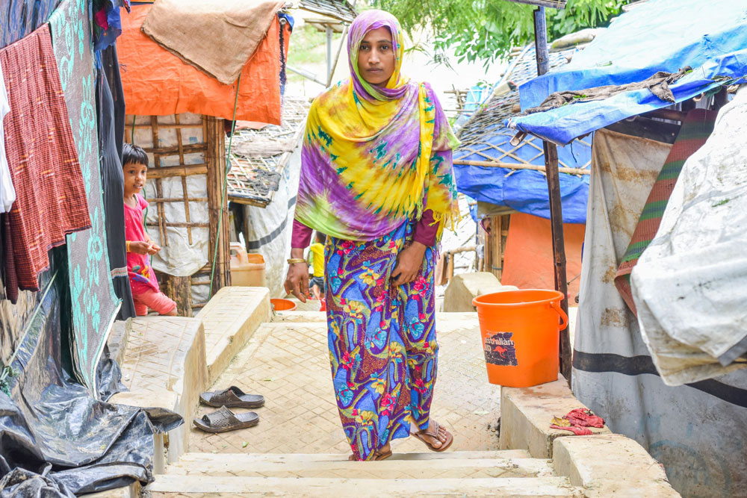
Monday 30 November
“Over all, the glory of the Lord will be… refuge and shelter...”
Isaiah 4:5-6
  Seeking shelter
  Saba and her children are living in Cox’s Bazar refugee camp in Bangladesh.
  They fled Myanmar and walked through the forest to escape persecution. Saba’s husband was kidnapped.
  Along with other support, the family was given a shelter kit by Caritas Bangladesh.
  Saba says: “During the monsoon season, we face storms and wind, therefore tarpaulin support for that time is very urgent for us."
Notes:
Picture credit: Inmanuel Chayan Biswas/Caritas Bangladesh

Slide 5
  Coronavirus is making life harder in the camp and Saba says it is difficult to keep socially distanced in such a crowded place.
  But her faith in God sustains Saba:
  “In our houses, we pray five times daily… We especially pray for returning back to our own place.”
  She is also comforted by the care given by the global Caritas family, including CAFOD:
  “I feel peace somehow when
  I am reminded of Caritas and its people who have been helping us.”
  Lord, comfort my sisters and brothers who are seeking refuge and shelter. Amen
“Over all, the glory of the Lord will be… refuge and shelter...”
Isaiah 4:5-6
Say this prayer for refugees or make up your own to say five times today.
Notes:
Picture credit: Inmanuel Chayan Biswas/Caritas Bangladesh

Slide 6
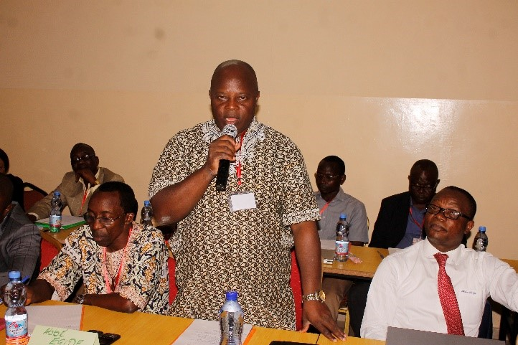
Tuesday 1 December
“In his days justice shall flourish
and peace till the moon fails.”
Psalm 71
  Message the brave
  Many people risk their lives to protect others and our common home. Last year more than 300 human rights defenders and environmental activists were killed.
  So, on Tuesdays in Advent we’ll meet some of the brave defenders supported by CAFOD.
  Father Alfred Buju defends the rights of people against mining companies in the Democratic Republic of Congo.
  He says: “Without sacrifice, there cannot be change.”
Father Alfred Buju
Notes:
Picture credit: CAFOD

Slide 7
  Father Alfred has been attacked and he has received death threats.
  The first days of Advent look ahead to the fulfilment of today’s psalm, when Christ returns at the end of time, justice flourishes and there is peace forever.
  But we don’t have to wait until then to live in God’s kingdom – Jesus said that it is all around us. We are called to live justly and peacefully right now!
  Holy Spirit, inspire me with a spirit of compassion and true justice so that I will be a peacemaker wherever I go. Amen.
“In his days justice shall flourish
and peace till the moon fails.”
Psalm 71
Send a Christmas message to this brave human rights defender.
Notes:
Picture credit: CAFOD

Slide 8
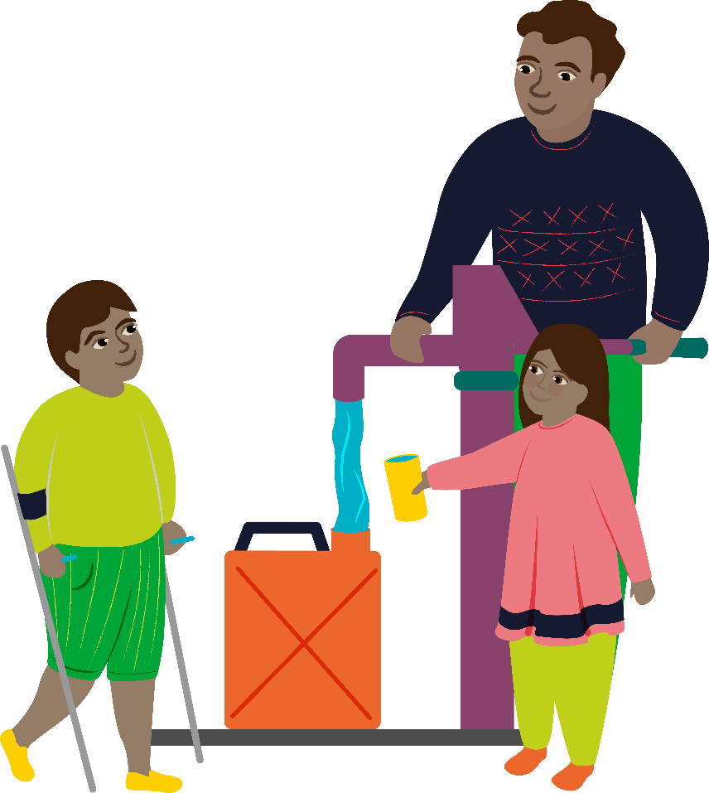
Wednesday 2 December
“The Lord God will wipe away the tears from every cheek.”
Isaiah 25:8
  World Gifts
  World Gifts are available all year, but some schools fundraise to give them as Christmas presents.
  This year, we’ve included gifts such as PPE for a health worker, that can help poor communities trying to cope with coronavirus.
  Water for a family can provide families with a steady supply of clean, safe water for drinking and cooking. Using a water pump also means families can wash in clean water, keeping everyone safe from infection.
Water for a family
£33

Slide 9
  The prophet Isaiah promises that God will wipe away tears. God uses our hands to wipe away tears and to offer support.
  CAFOD’s global network is supporting poor communities who are struggling due to the pandemic. You can be part of this work through World Gifts.
  Lord, help me to be aware of other people’s sorrows today. Help me to bring comfort and hope. Amen.
“The Lord God will wipe away the tears from every cheek.”
Isaiah 25:8
Water for a family
£33
Decide which of the World Gifts your class might buy this Christmas.

Slide 10
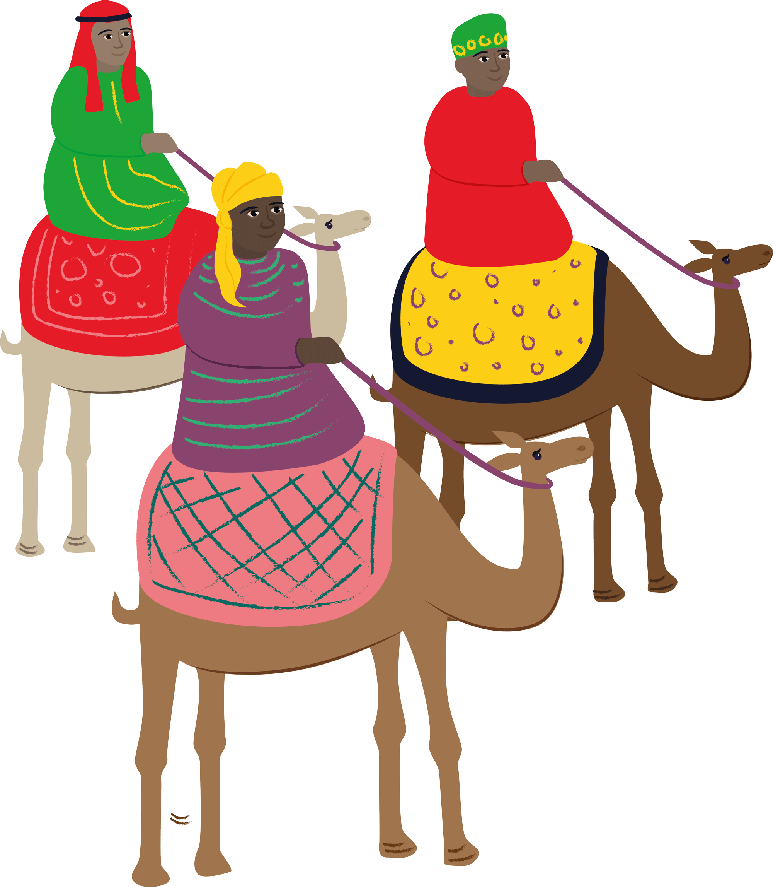
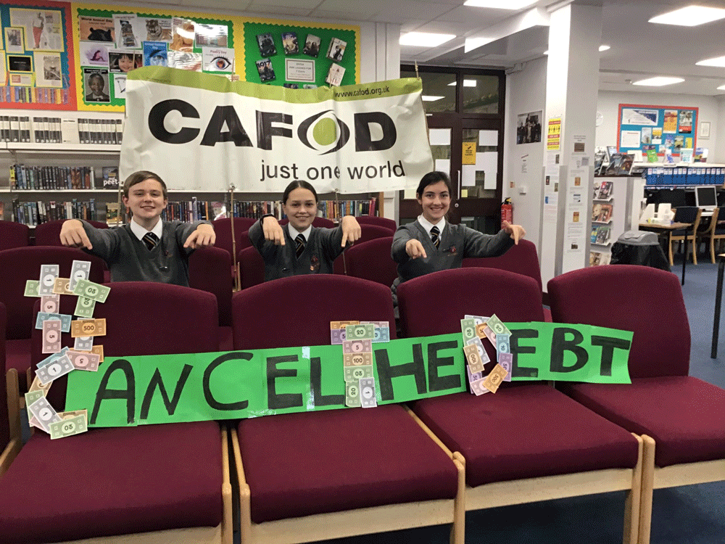
Thursday 3 December
“Everyone who listens to these words of mine and acts on them ..”
Matthew 7:24
  Taking action
  Charlie, May and Maisie were three of those who campaigned this year for world leaders to cancel the debts owed by many developing nations.
  Graham Gordon, Head of Policy at CAFOD said:
  “Governments in debt will continue to be forced to pay interest on their debts, when they need that money to spend on health and social care systems to save lives.”

Slide 11
  Sadly the G20, 20 of the world’s most powerful leaders, failed to fully cancel the debts, despite this campaign for compassion and justice.
  The campaign continues.
  Today’s gospel reminds us that when we act on the words of Jesus, what we do has a firm foundation.
  Lord, may we always be ready to act on your words, “whatever you did to the least of these… you did it to me”. Sustain us when the struggle is long. Amen.
“Everyone who listens to these words of mine and acts on them ..”
Matthew 7:27
Find out about taking action with CAFOD

Slide 12
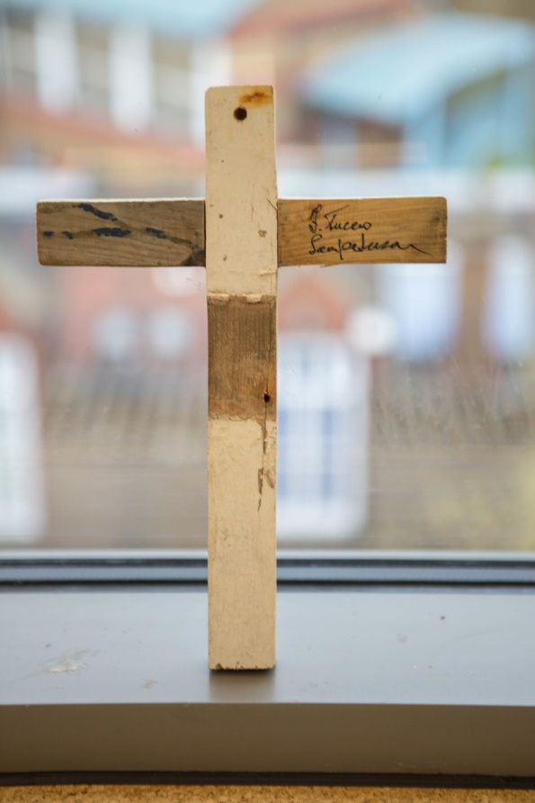
Friday 4 December
“He touched their eyes…
and their sight returned”
Matthew 9:29-30
  Seeing with new eyes
  Francesco Tuccio, a carpenter in Lampedusa, Italy, made crosses from the wood of a wrecked migrant boat as a symbol of hope for the survivors. We asked Francesco to make some more crosses as a focus for prayer.
  12-year-old Eion from Crawley told us: “I feel privileged to hold something so special; someone has taken the time to find the pieces and put this together. It shows that people really do care.”
Notes:
Picture credit: CAFOD

Slide 13
  Every diocese in England and Wales has at least two Lampedusa crosses.
  Because Francesco Tuccio’s heart was touched with compassion he saw the potential in simple pieces of wood to become a powerful sign of hope.
  If Jesus touches our hearts as he touched the eyes of the blind men in today’s reading, who knows what we might see?
  Lord, touch my heart today so that I can see the wonders you are able to do through me. Amen.
“He touched their eyes…
and their sight returned”
Matthew 9:29-30
Ask your local CAFOD volunteer centre if you can borrow a cross.
Notes:
Picture credit: CAFOD

Slide 14
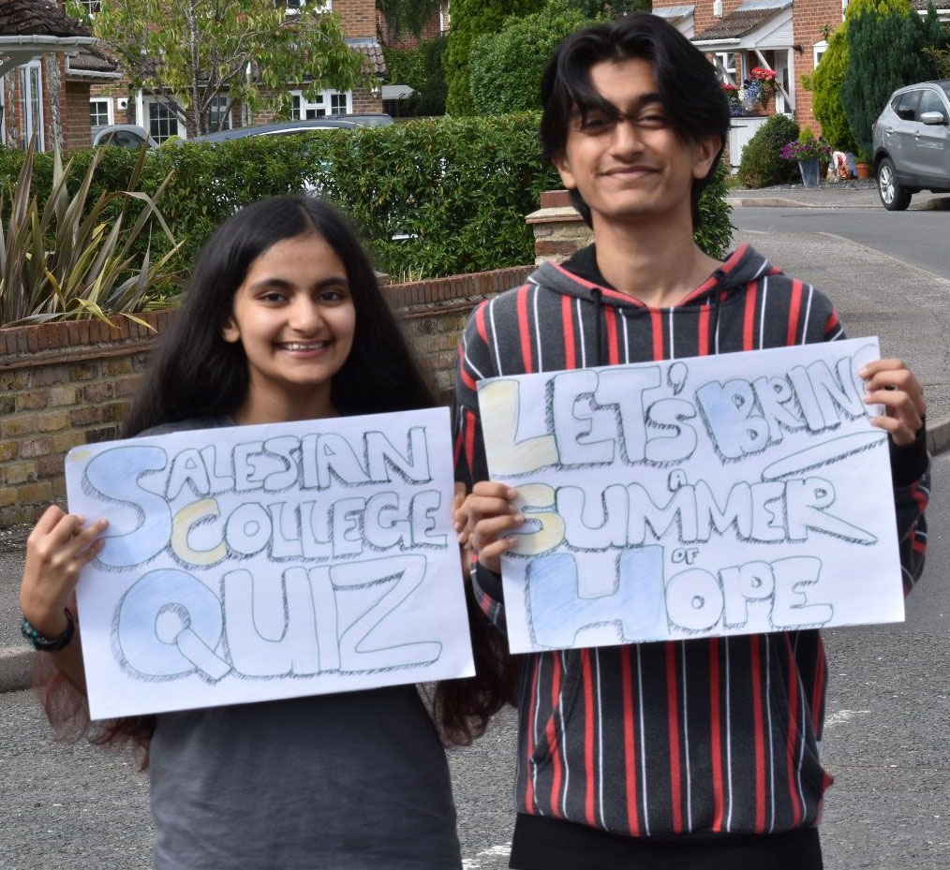
Saturday 5 December
“You received without payment; give without payment.”
Matthew 10:8
  Summer of hope
This summer, we invited everyone to creatively turn events they’d miss, due to Covid, into fundraisers to bring hope to poor communities affected by the pandemic.
We heard of garden camping, long pilgrimage walks, virtual coach trips and summer fayres…
Salesian College, Farnborough held an online quiz, Maricourt High School walked and ran, and 16-year-old Josna George and his brother cycled 400 miles each!

Slide 15
  In today’s gospel, Jesus feels sorry for the crowds and sends out his disciples to heal them and to share the good news with them:
  “You received without payment; give without payment”.
  Thousands of you reached out to others and gave without payment this year to help communities in poverty… and had fun too!
  Thank you!
  Lord, help me never to be hard of heart. Make me brave enough to dare to care. Amen.
“You received without payment; give without payment.”
Matthew 10:8
Watch our one-minute Summer of Hope thank you video!

Slide 16
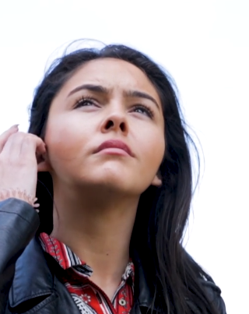

Sunday 6 December
Second Sunday of Advent
“A voice cries in the wilderness: Prepare a way for the Lord, make his paths straight.”
Mark 1:3
  Leila’s story
  Leila was brought up by her grandmother in London. She told us that she feels blessed and that her experiences and her faith mean she now stands up for others:
  “I think I’m passionate about being at the forefront of campaigns and using my voice, because I want other young women to see that you can go wherever you want in the world, be whoever you want to be, and make a difference.”
  Leila
Notes:
Picture credit: CAFOD

Slide 17
  Today’s gospel tells us that John the Baptist was a voice crying in the wilderness, making straight the way for the Lord’s coming.
  We may feel our voice echoes in a wilderness and is ignored, but Leila’s story proves that no one is too young to influence people in power.
  How will I influence people today?
  Lord, John the Baptist prepared the way for your coming. Help me to prepare too. Amen.
“A voice cries in the wilderness: Prepare a way for the Lord, make his paths straight.”
Mark 1:3
Watch this inspiring four-minute film of Leila’s story.
Notes:
Picture credit: CAFOD

Slide 18
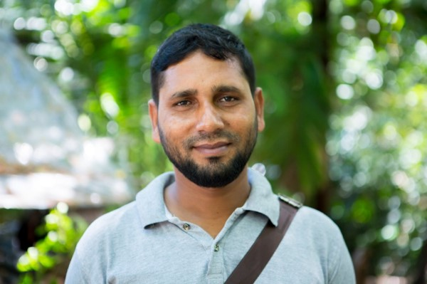
Monday 7 December
“We have seen incredible things today.”
Luke 5:26
  Making a difference
  The local experts who work with CAFOD around the world have been adapting their work this year to meet coronavirus challenges.
  Jamal, from Caritas Bangladesh, says:
  “The suffering of vulnerable people due to coronavirus in this area is beyond words. Day to day, the need is going up, and help is needed for more families.”
Notes:
Picture credit: Louise Norton/CAFOD

Slide 19
  Jamal has given out essential items like soap, washing powder and face masks to vulnerable families whose incomes have disappeared as they cannot go out to work, people who are left without basic necessities.
  In today’s gospel, people say they have seen incredible things.
  Soap may not seem an incredible thing but for vulnerable people it can be life-saving.
  What simple but incredible things are you grateful for this year?
  Lord, thank you for your gifts. Teach me to share them. Amen.
“We have seen incredible things today.”
Luke 5:26
Tell one person today about something you are grateful for this year.
Notes:
Picture credit: Louise Norton/CAFOD

Slide 20
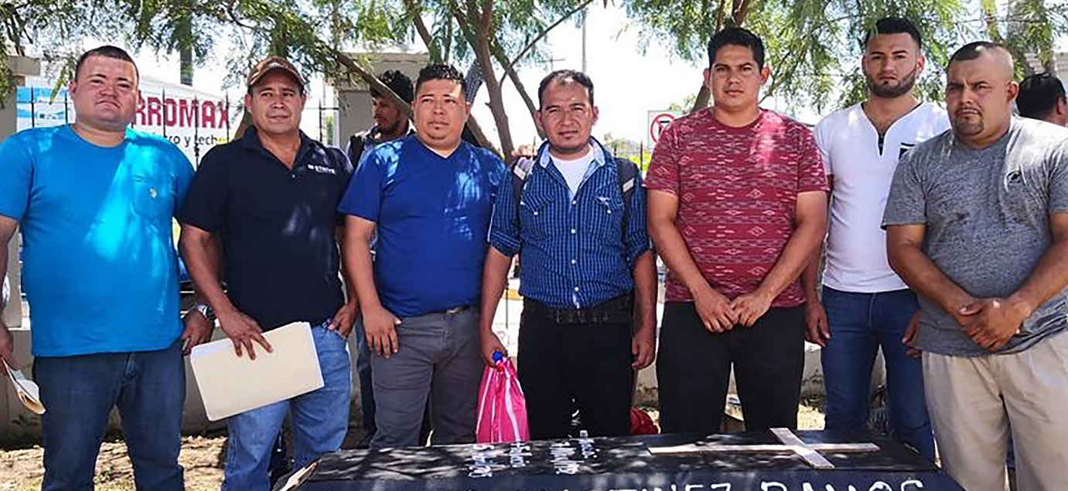
Tuesday 8 December
The Immaculate Conception
“…nothing is impossible to God.”
Luke 1:37
  Message the brave
  Honduras is one of the most dangerous countries in the world to defend the environment.
  The Guapinol Water Defenders seek a voice for local people as large-scale farming and mining are destroying land and rivers.
  “Our struggle is just. We stand for water and life for all. We demand that the mining company leave, because what it brings us is pollution and damage to the environment.”
Guapinol Water Defenders
Notes:
Picture credit: ERIC

Slide 21
  Today we remember the angel telling Mary that all things are possible to God, even for her elderly cousin Elizabeth to have a baby – John the Baptist.
  We pray that the Guapinol Water Defenders may also experience God’s power in their struggle.
  Find out more: guapinolresiste.org
  Lord, defend your people! Inspire me to stand against injustice wherever I encounter it. Amen.
“…nothing is impossible to God.”
Luke 1:37
Send a Christmas message to these brave defenders.
Notes:
Picture credit: ERIC

Slide 22
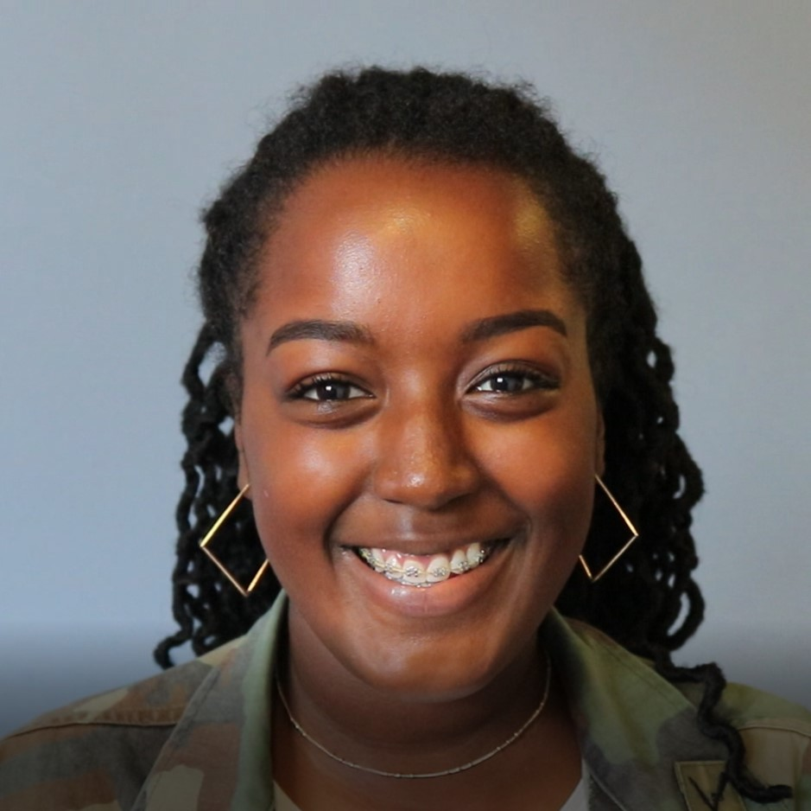
Wednesday 9 December
“Lift up your eyes and look.
Who made these stars…?”
Isaiah 40:26
  Young leader
  Azaria trained last year as a CAFOD young leader in Southwark, London. She said:
  “We are the future and without us young people, the future will go nowhere!”
  About 300 sixth formers took part. Many said they want to help make the world a better place for its poorest people. Azaria agreed:
  “I care a lot about the environment and equality - everyone should get equal rights.”

Slide 23
  God made billions of stars, but Isaiah shows us how much God cares about creation, as he calls each of the stars by name.
  Azaria cares about equal rights and the environment and gave up her time to train with CAFOD.
  What do you care about, so much that you are willing to give time and effort to promoting or protecting it?
  God our Father, you made and treasure every planet, every star and every person. Help me to do the same. Amen.
“Lift up your eyes and look.
Who made these stars…?”
Isaiah 40:26
Show or tell someone today that you care about them.

Slide 24
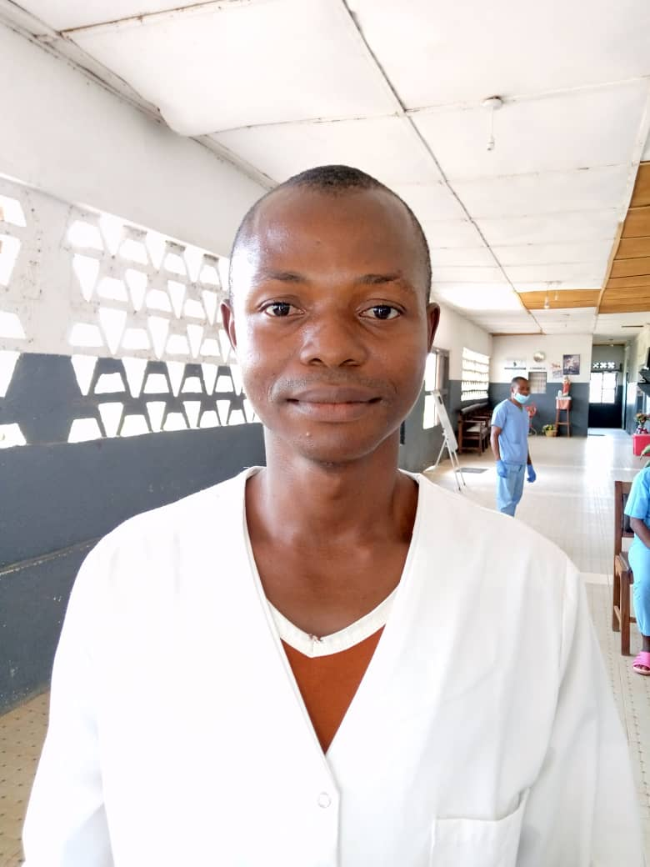
Thursday 10 December
“Do not be afraid, I will help you.”
Isaiah 41:13
  Coronavirus work
  “With CAFOD's help I have full confidence when I'm working because they've provided all the PPE the clinic needs,” says Mustapha John-Lappia, lab technician at Handmaids Catholic Health Clinic, Sierra Leone.
  Before the PPE arrived, health workers in the clinic felt too unsafe to treat anyone. Patients began to stop visiting because they didn’t feel safe receiving treatment either.
  Things are changing for the better.
Notes:
Picture credit: Handmaid Sisters of the Holy Child Jesus

Slide 25

  Since receiving the PPE, Mustapha and his colleagues feel far more confident. Seeing the increased confidence of health staff, patients have also started to return.
  Today’s reading tells us not to be afraid. We can help
  each other to
  overcome fears too
  – as the World Gift
  PPE for a health
  worker is doing.
  Lord, I give my own fears to you. Show me how to help others overcome their fears too. Amen
“Do not be afraid, I will help you.”
Isaiah 41:13
Sr Veronica from Sierra Leone tells us how this World Gift makes a difference.
Notes:
Picture credit: Handmaid Sisters of the Holy Child Jesus

Slide 26
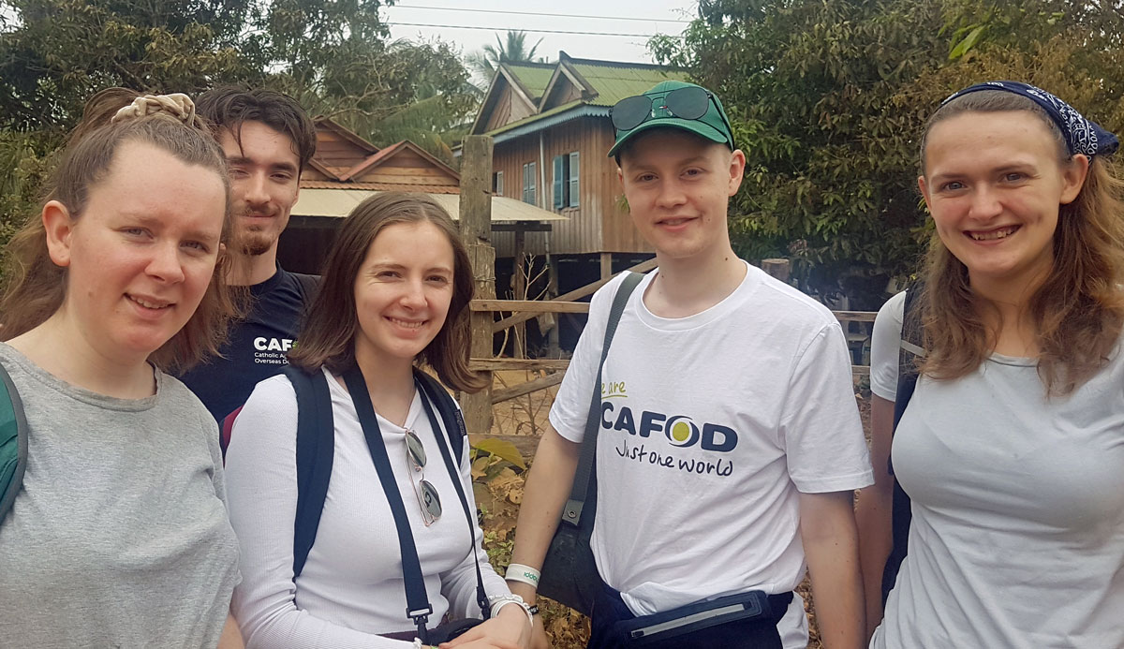
Friday 11 December
“I, the Lord your God… lead you
in the way that you must go.”
Isaiah 48:17
  Step into the gap
  Every year, young adults apply for CAFOD’s gap year programme, Step into the gap.
  If successful, they spend the year promoting global justice by working with young people at retreat centres, schools and universities. In a normal year, they also spend a few days visiting programmes supported by CAFOD overseas.
  In February, Rebecca, Francis, Orla, Hugh and Daisy visited Cambodia.
Notes:
Picture credit: Julia Corcoran/CAFOD

Slide 27
  Orla recalls visiting one community transformed by a chicken rearing project:
  “One villager we visited had started with four hens. A year later she has over 20. The absolute delight of the lady highlighted how it had completely changed her life… These people are powerful and full of life – they are capable of doing so many amazing things.. It is impossible to go into these communities and not be a changed person by the end.”
  Where is God leading me and what can I learn from the people who walk beside me?
  Lord, lead me on the way that I should go. Amen.
“I, the Lord your God… lead you
in the way that you must go.”
Isaiah 48:17
Find out about our Step into the Gap programme.
Notes:
Picture credit: Julia Corcoran/CAFOD

Slide 28
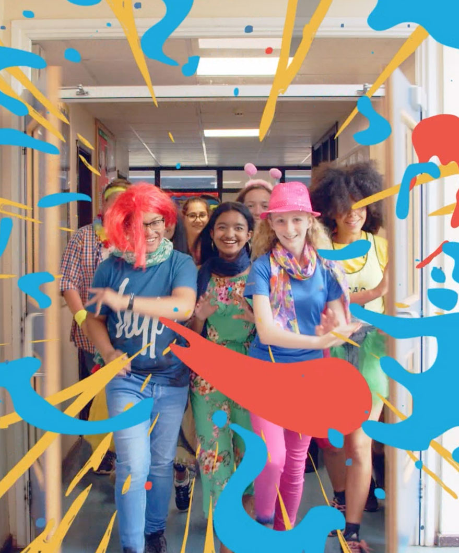
Saturday 12 December
“Elijah has come already and they did not recognise him…”
Matthew 17:12
  Harvest like no other
  This Harvest was a harvest like no other – so that’s the title we used for our live assembly for schools. Maybe your school joined us?
  We told the story of the first ever Family Fast Day, and how it was started by some ordinary women with no experience of fundraising but a desire to respond to a need.
  The need of poor communities today, 60 years later, has been magnified by the pandemic.

Slide 29
  In today’s gospel, people did not recognise that the spirit of the Prophet Elijah, whose return had been awaited, was present in John the Baptist.
  Perhaps people didn’t want to see - recognising the truth of what is going on around us obliges us to do something about it.
  What is happening around me that I have not recognised?
  God of Wisdom, help me to
  see the truth and to accept the challenge to respond. Amen.
“Elijah has come already and they did not recognise him…”
Matthew 17:12
Remind yourself of our harvest film for Family Fast Day.

Slide 30
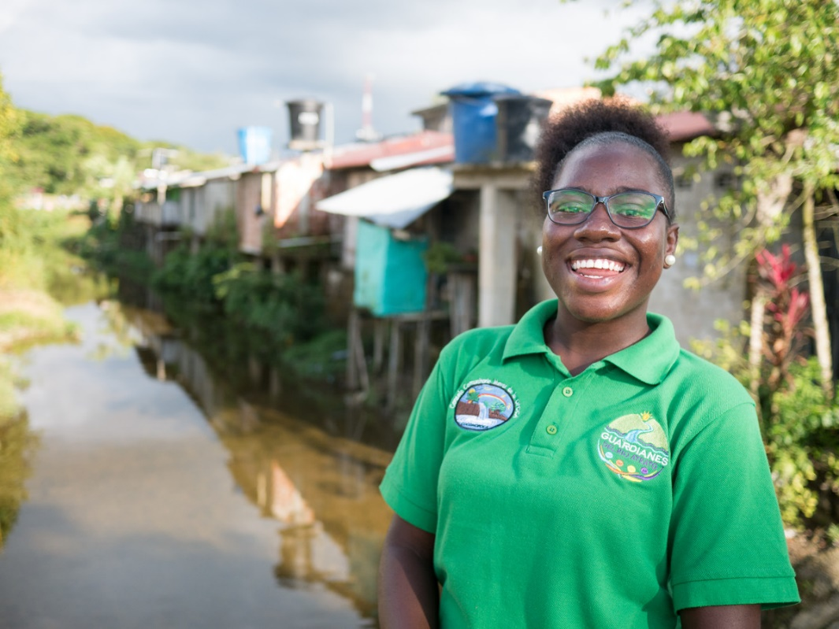
Sunday 13 December
Third Sunday of Advent
Gaudete (Rejoice) Sunday
“I exult for joy in the Lord,
my soul rejoices in my God…”
Isaiah 61:10
  Young Guardians
  Dana is part of a group in Yuto, Colombia called the Young Guardians of the Atrato River.
  Pollution of the river by activities such as illegal gold mining is threatening a whole way of life.
  The Young Guardians learn about the legal ruling that protects the river, raise awareness in their community, and do actions such as cleaning the Doña Josefa creek, which flows into the river.
Notes:
Picture credit: Matts Olsson

Slide 31
  It is now four years since the Colombian courts ruled that the river had the right to be protected.
  Local communities had battled for many years to achieve this ruling.
  Yet it is still being ignored by many industries along the riverbanks.
  The Guardians will continue to stand up for the rights of the river and its communities and believe they will achieve their goal – future generations enjoying life beside a clean river.
  How can you bring joy to someone today?
  Lord, help me bring joy! Amen.
“I exult for joy in the Lord,
my soul rejoices in my God…”
Isaiah 61:10
Order World Gifts by 16 December for postal delivery before Christmas.
Notes:
Picture credit: Matts Olsson

Slide 32
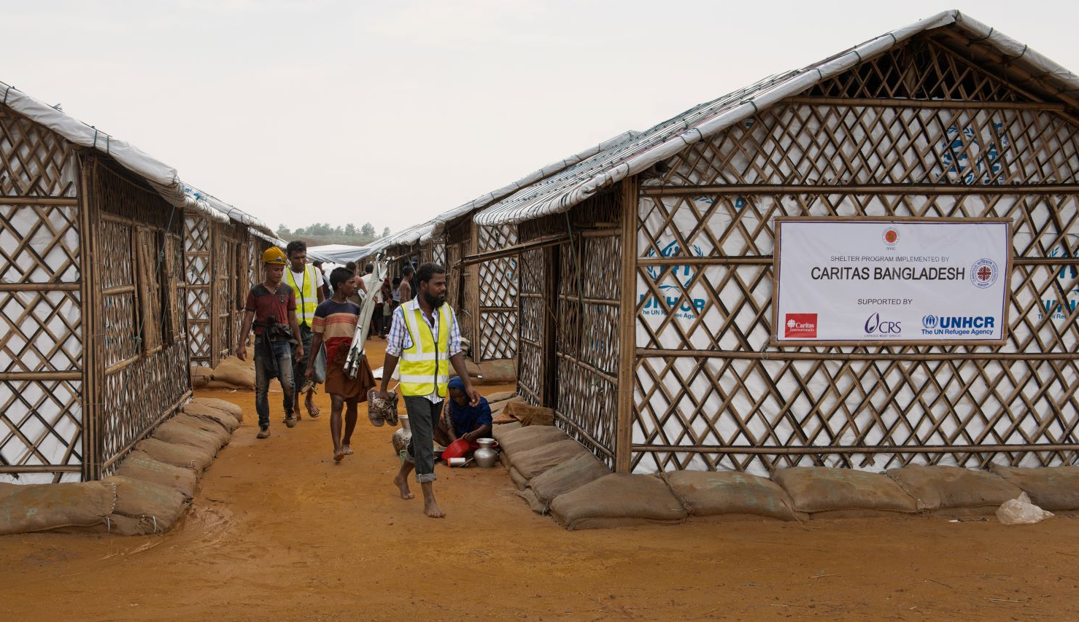
Monday 14 December
“I see him, but not in the present,
I behold him, but not close at hand.”
Numbers 24:17
  Refugees
  Thousands of Rohingya people are still living in camps in Bangladesh after being driven from their homes in Myanmar three years ago.
  Many people dream of returning home but it is still not safe to do so.
  Through the global Caritas network of the Catholic Church, CAFOD has supported people to build stronger temporary homes in the camps.
Notes:
Picture credit: Ismail Ferdous for Catholic Relief Services

Slide 33
  In today’s reading, the prophet Balaam has been asked by the king to curse his enemies, the Israelites.
  But, instead of a curse, Balaam prophesies a blessing - a leader who would save his people. Centuries later, Jesus was born.
  How can my words be a blessing to those I meet today?
  Lord of justice, we pray for all those negotiating their right to a safe home. Bless their words that they may achieve a just solution. Amen.
“I see him, but not in the present,
I behold him, but not close at hand.”
Numbers 24:17
Spend one minute imagining life as a refugee. Say a prayer for peace.
Notes:
Picture credit: Ismail Ferdous for Catholic Relief Services

Slide 34
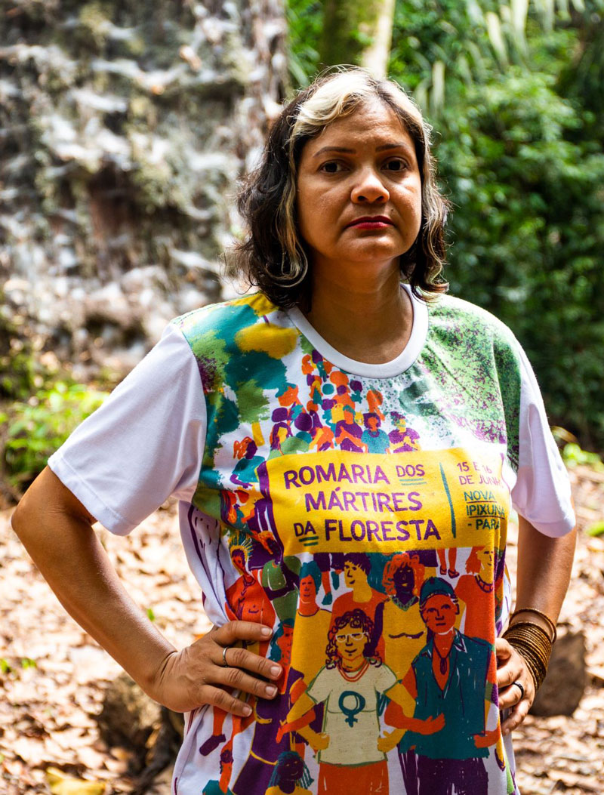
Tuesday 15 December
“The son answered ‘I will not go’ but
afterwards thought better of it and went…”
Matthew 21:31
  Message the brave
  Claudelice’s brother and sister-in-law were killed for resisting the deforestation and illegal logging that have stripped and degraded vast areas of the Brazilian Amazon.
  Now life is dangerous for Claudelice too, but she says:
  “The Amazon is our life… Although I’m afraid, it doesn’t mean I’m going to stop. The rights of people are being taken away.”
Claudelice Silva dos Santos
Notes:
Picture credit: Thom Flint/CAFOD

Slide 35
  In today’s reading, the brother who at first refused to work, later changes his mind and goes to work in his father’s vineyard.
  Advent is a good season to remember the times we have not done what we ought to have done… and to get on with it!
  As Claudelice knows, our actions count.
  What have I neglected to do?
  Lord, I’m sorry that I sometimes avoid your call. Help me to change course and to serve others as you did. Amen.
“The son answered ‘I will not go’ but
afterwards thought better of it and went…”
Matthew 21:31
Send a Christmas message of solidarity to this brave defender.
Notes:
Picture credit: Thom Flint/CAFOD

Slide 36
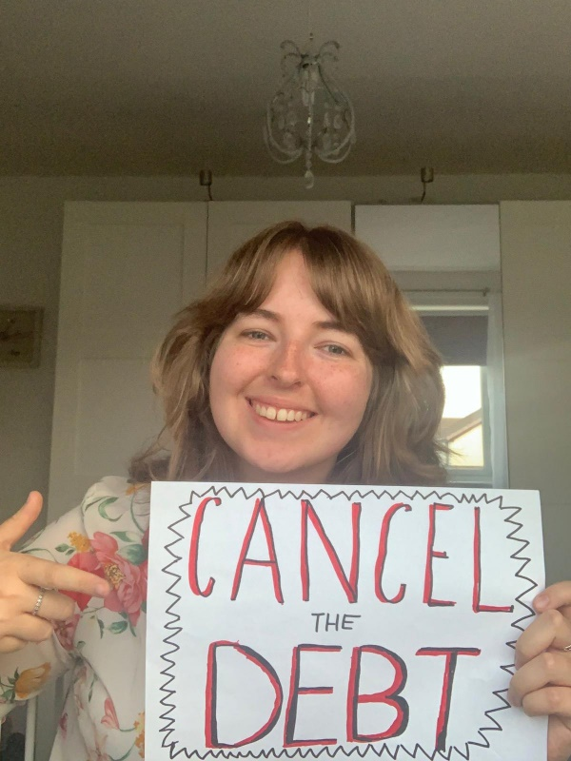
Wednesday 16 December
“I will hear what the Lord God has to say,
a voice that speaks of peace.”
Psalm 84:9
  Gap year like no other
  Hannah Bartlett is on this year’s CAFOD gap year programme. She is based at the Youth Mission Team in Consett, County Durham.
  Normally, a CAFOD gap year also includes a visit overseas. This year is different, due to the pandemic.
  But Hannah already knows that it’s possible to hear amazing stories and be changed by them without travelling to far away lands.
  She heard of CAFOD at school...

Slide 37
  “The stories I heard of people and their communities who have been so positively impacted by CAFOD partners inspired me to apply for Step into the Gap and do my part to amplify the voices of those who often go unheard.”
  Today’s psalm reminds us that God has amazing things to say too.
  Our lives are busy, technology demands our attention and it can be hard to find time to be properly silent and just listen.
  Where can you find space to listen today?
  Lord, speak peace to my heart today. Amen
“I will hear what the Lord God has to say,
a voice that speaks of peace.”
Psalm 84:9
Find a quiet place and just listen to God for one minute today.

Slide 38
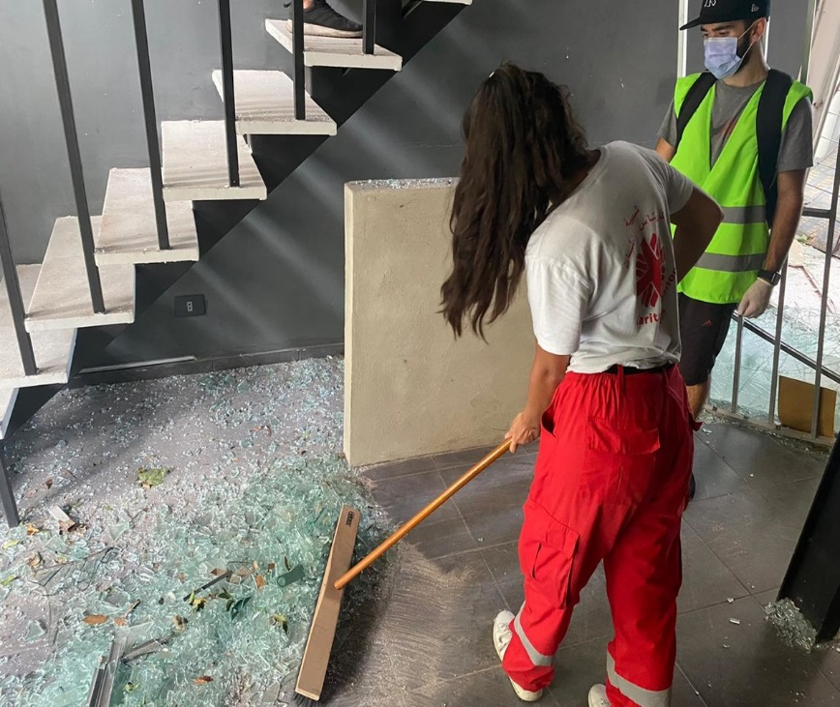
Thursday 17 December
“The sceptre shall not pass from Judah… until he comes to whom it belongs…”
Genesis 49:10
  Beirut, Lebanon
  In August, a huge explosion in a warehouse in Beirut killed more than 200 people and made more than 300,000 others homeless.
  Caritas Lebanon, supported by CAFOD, distributed food, water and other essentials, and its medical team provided first aid, consultations and medicines.
  More than 200 volunteers from Caritas Youth helped clean streets, homes and other buildings such as churches.
Notes:
Picture credit: Caritas Lebanon

Slide 39
  Communities in Lebanon already coping with poverty and coronavirus had no idea an explosion was about to make things even worse.
  Young people in the Caritas family, to which CAFOD belongs, stepped up and lived their commitment to make a difference. The work continues.
  Today’s Mass readings are all about God’s promise, fulfilled in Jesus.
  What promise or commitment can I make for the coming year?
  Lord, help me to fulfil the promises I make. Amen.
“The sceptre shall not pass from Judah… until he comes to whom it belongs…”
Genesis 49:10
Write a new year’s resolution and put it somewhere visible.
Notes:
Picture credit: Caritas Lebanon

Slide 40
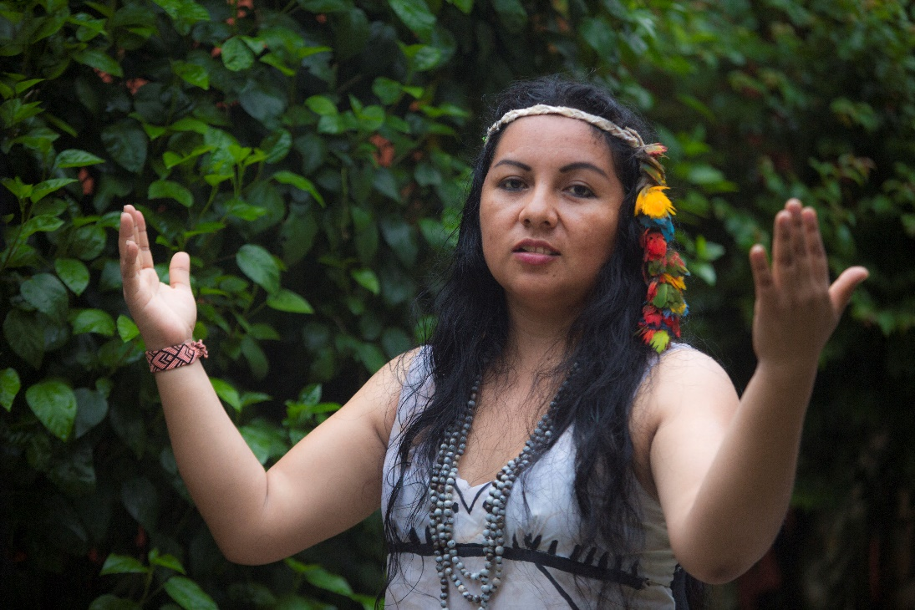
Friday 18 December
“…and they shall name him Emmanuel, which means ‘God is with us.’”
Matthew 1:23
  COP26
  This autumn, world leaders were due to meet in Glasgow for vitally important meetings – known as COP26 – about the climate crisis.
  Due to the pandemic, those talks will now be held in November 2021.
  CAFOD, and the rest of the Caritas global Catholic network, will be campaigning to raise awareness of the issues and to call on world leaders to make radical decisions.
Notes:
Picture credit: Pavel Martiarena Huamán

Slide 41
  It is easy to feel overwhelmed by the scale of the climate crisis and the loss of biodiversity.
  But today’s gospel reminds us that God is with us.
  We do have the power to turn things around, if we work together.
  God with us, remind me of your power when I feel overwhelmed. Amen.
“…and they shall name him Emmanuel, which means ‘God is with us.’”
Matthew 1:23
Watch Hector and Yesica defending the Amazon, and be inspired!
Notes:
Picture credit: Pavel Martiarena Huamán

Slide 42
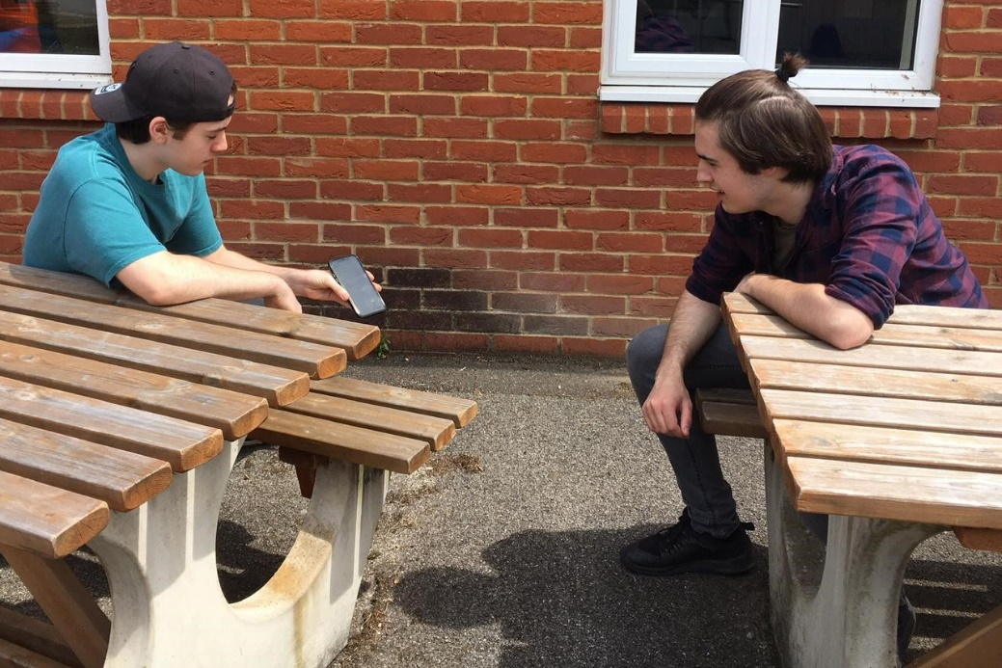
Saturday 19 December
“I was sent to speak to you and to announce to you this good news.”
Luke 1:19
Good news travels
  In today’s gospel, the angel is sent to tell Zechariah the good news that his wife, Elizabeth, will have a baby.
  Can you recall sharing a bit of good news with your friends or family? How did it feel?
  Today’s passage is from the start of Luke’s gospel. It’s a hint of things to come. All through this gospel Jesus proclaims the good news of the kingdom of God. He also sends his followers out to proclaim the good news too.

Slide 43
  We are his disciples today.
  It is only a few days now before we celebrate the good news that Jesus was born for us. Sometimes that joyful message can seem lost behind tinsel and lists.
  How will you remind people of the real good news of Christmas?
  Jesus, your birth is a joyful message of hope for all people who are suffering. Help me to share it. Amen
“I was sent to speak to you and to announce to you this good news.”
Luke 1:19
Put together a message that will share the joy of Christmas and bring hope.

Slide 44
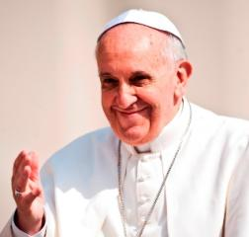
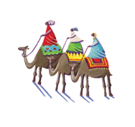
Sunday 20 December
Fourth Sunday of Advent
“Let what you have said be done to me.”
Luke 1:38
  Year of the Word
  This is the Year of the Word.
  The Bible is a place we can go to seek wisdom about how to live.
  For example, Pope Francis said:
  “Biblical revelation urges us to welcome the stranger; it tells us that in so doing, we open our
  doors to God, and that in the faces of others we see the face of Christ himself.”
Notes:
Picture credit: Mazur/Catholicnews.org.uk

Slide 45
  In today’s gospel, Mary accepts the angel’s words and her calling to become the mother of Jesus. What can this scripture teach us?
  Well, we talk a lot about doing, far less about accepting. Sometimes we see accepting as weakness. Mary is evidence that this is not so. She was a strong young woman facing a huge challenge.
  What might I need to accept?
  Mary, pray for me to accept what God is calling me to do and to respond as generously as you did. Amen.
“Let what you have said be done to me.”
Luke 1:38
Look out for opportunities to say ‘yes’ today when you are asked to help.
Notes:
Picture credit: Mazur/Catholicnews.org.uk

Slide 46
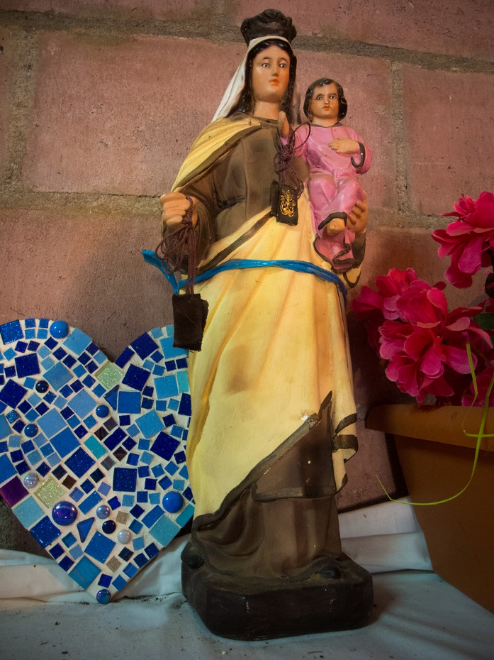
Monday 21 December
“Blessed are you who believed that what was spoken to you by the Lord would be fulfilled.”
Luke 1:45
  I don’t believe it!
  How often do we say “I don’t believe it” or even “I can’t believe it” when something outrageous happens?
  Mary could justifiably have said the same to the angel, Gabriel.
  “Son of God? The power of the Lord will overshadow me? I don’t believe it! What about Joseph?”
  But Mary chose to believe the outrageous promise of the Lord.
Statue in Puentecitos, El Salvador
Notes:
Picture credit: Tania Dalton/CAFOD

Slide 47
  Elizabeth, in today’s reading, tells Mary she is blessed because of her choice to believe the Lord’s word.
  In this Year of the Word, which word or phrase in scripture speaks most strongly to you? One that means a lot to us at CAFOD is: “He sent me to bring good news to the poor.”
  If you’re not sure, dust off that Bible or search that app and see what jumps out at you. Perhaps God has a special word for you today.
  Jesus, thank you for your promises. Help me to believe. Amen.
“Blessed are you who believed that what was spoken to you by the Lord would be fulfilled.”
Luke 1:45
Read and ponder a word or phrase from scripture.
Notes:
Picture credit: Tania Dalton/CAFOD

Slide 48
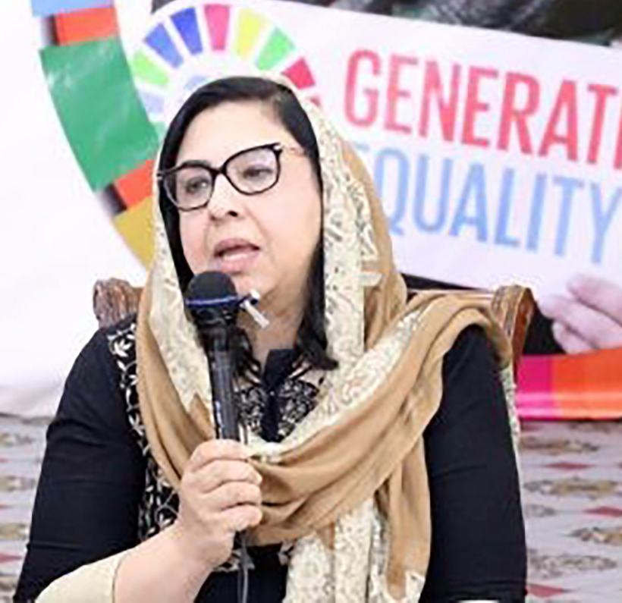
Tuesday 22 December
“…the Almighty has done great things for me, and holy is his Name
Luke 1:49
  Message the brave
  Palwasha Hassan lives in Afghanistan. She has spent her life fighting for women’s rights.
  Amongst other initiatives, she has started up shelters for refugee women and for street children. She is now director of the Afghan Women’s Educational Centre.
  Palwasha says: “Peace is never real without an inclusive, equal society. We need to ensure women’s meaningful participation at all levels…”
Palwasha Hassan
Notes:
Picture credit: UN Women

Slide 49
  Today’s reading is the Magnificat – the revolutionary song of Mary that is so vocal about God’s defence of oppressed people that it was banned by at least three governments in the last century.
  (See if you can find out which – you may be surprised!)
  Let us pray that God will defend the oppressed in all societies and that we will defend them too.
  Lord, help us to build a world where everyone has a voice and is listened to with respect. Amen
“…the Almighty has done great things for me, and holy is his Name
Luke 1:49
Send a message of encouragement to this brave defender.
Notes:
Picture credit: UN Women

Slide 50
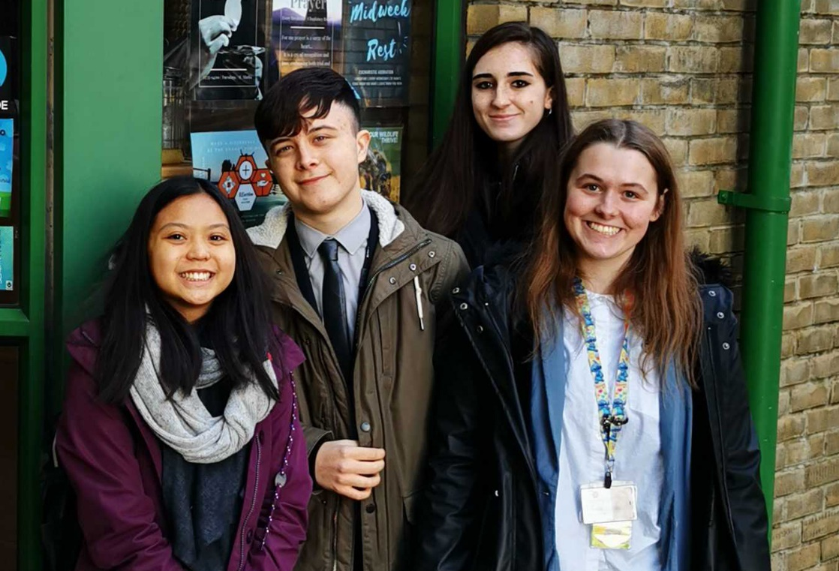
Wednesday 23 December
“‘What, then, will this child be?’
For surely the hand of the Lord was with him.”
Luke 1:66
  Young leaders
  These are just some of the students who graduated as CAFOD young leaders last term.
  Each year, CAFOD runs a young leaders course. Representatives from schools meet together in local regions to learn about global justice, then share what they have learned with their own school.
  This year, meeting in a virtual space has meant an even wider encounter, with young people from all over the country.

Slide 51
  In today's reading, people talk about what John the Baptist might become. They can see that the Lord is with him and know this means he will be amazing.
  The Lord is with the young leaders this year as they discuss global issues and seek justice for poor communities overseas.
  And the Lord is with you too! With God's help, we can all be amazing.
  Lord, let your hand be with me to shape me into the best person I can be. Do amazing things through me. Amen.
“‘What, then, will this child be?’
For surely the hand of the Lord was with him.”
Luke 1:66
Find out about volunteering, either locally or with CAFOD.

Slide 52
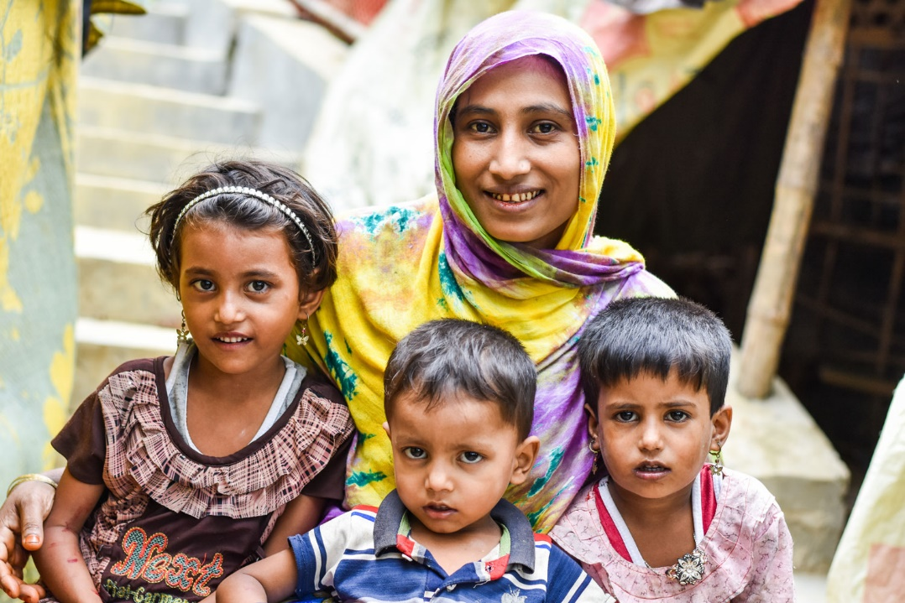
Thursday 24 December
Christmas Eve
“...the dawn from on high shall break upon us,
to shine on those who dwell in darkness…”
Luke 1:78-79
  Waiting in hope
  Saba, living in Cox’s Bazar refugee camp, told us:
  “We are holding a big hope that we could be able to return to Myanmar one day, we would get back my husband there also.”
  We’ve spent lots of time this year at home. Sometimes perhaps, we’ve wished to be elsewhere!
  Saba, and the other 80 million refugees in the world, remind us what a blessing it is to be able to be at home with our loved ones.
Notes:
Picture credit: Inmanuel Chayan Biswas/Caritas Bangladesh
Statistic: https://www.unhcr.org/uk/figures-at-a-glance.html

Slide 53
  While she waits in hope of the day they can go home, Saba says:
  “When I see my children’s faces, I forget all the sorrows that I have to endure… I have been learning to live happily with them and waiting for that day together. I hope, it will come to us with the grace of the Almighty.”
  Jesus’ birth in a stable is a powerful sign that God chose to enter into our darkness bringing hope to the world. May his light shine on and through us always.
  Lord, thank you for my home and family. Comfort all who are far from their home and loved ones. Amen.
“...the dawn from on high shall break upon us,
to shine on those who dwell in darkness…”
Luke 1:78-79
Save some Christmas money to donate for refugees.
Notes:
Picture credit: Inmanuel Chayan Biswas/Caritas Bangladesh

Slide 54
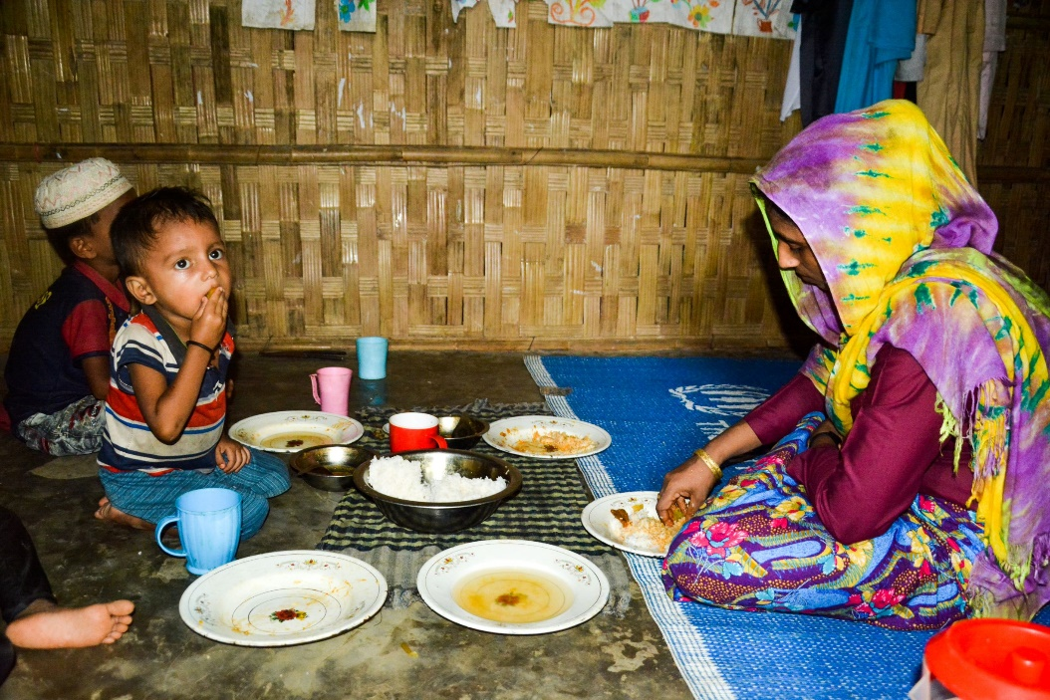
Friday 25 December
Christmas Day
“The shepherds went back glorifying and praising God…”
Luke 2:20
  Good news to share
  Today we celebrate the greatest gift of all – Jesus, given to us by the Father, born to bring good news to the poor.
  Jesus was born in a borrowed stable.
  Too many children are still born into poverty and many – like Saba’s children – live far from home, often in borrowed rooms or in refugee camps.
Notes:
Picture credit: Inmanuel Chayan Biswas/Caritas Bangladesh

Slide 55
  Today we thank God for the hope he gives us, that he will help us to build a just world where war and poverty are no more and where all children can grow up safely in their own homes with all they need to live life to the full.
  Like the shepherds - rejoice!
  Jesus, you enter into our poverty and transform it. Empower me with hope to live and share your good news for all. Amen.
“The shepherds went back glorifying and praising God…”
Luke 2:20
Say a Christmas grace before meals and thank God for all his blessings.
Notes:
Picture credit: Inmanuel Chayan Biswas/Caritas Bangladesh

Slide 56
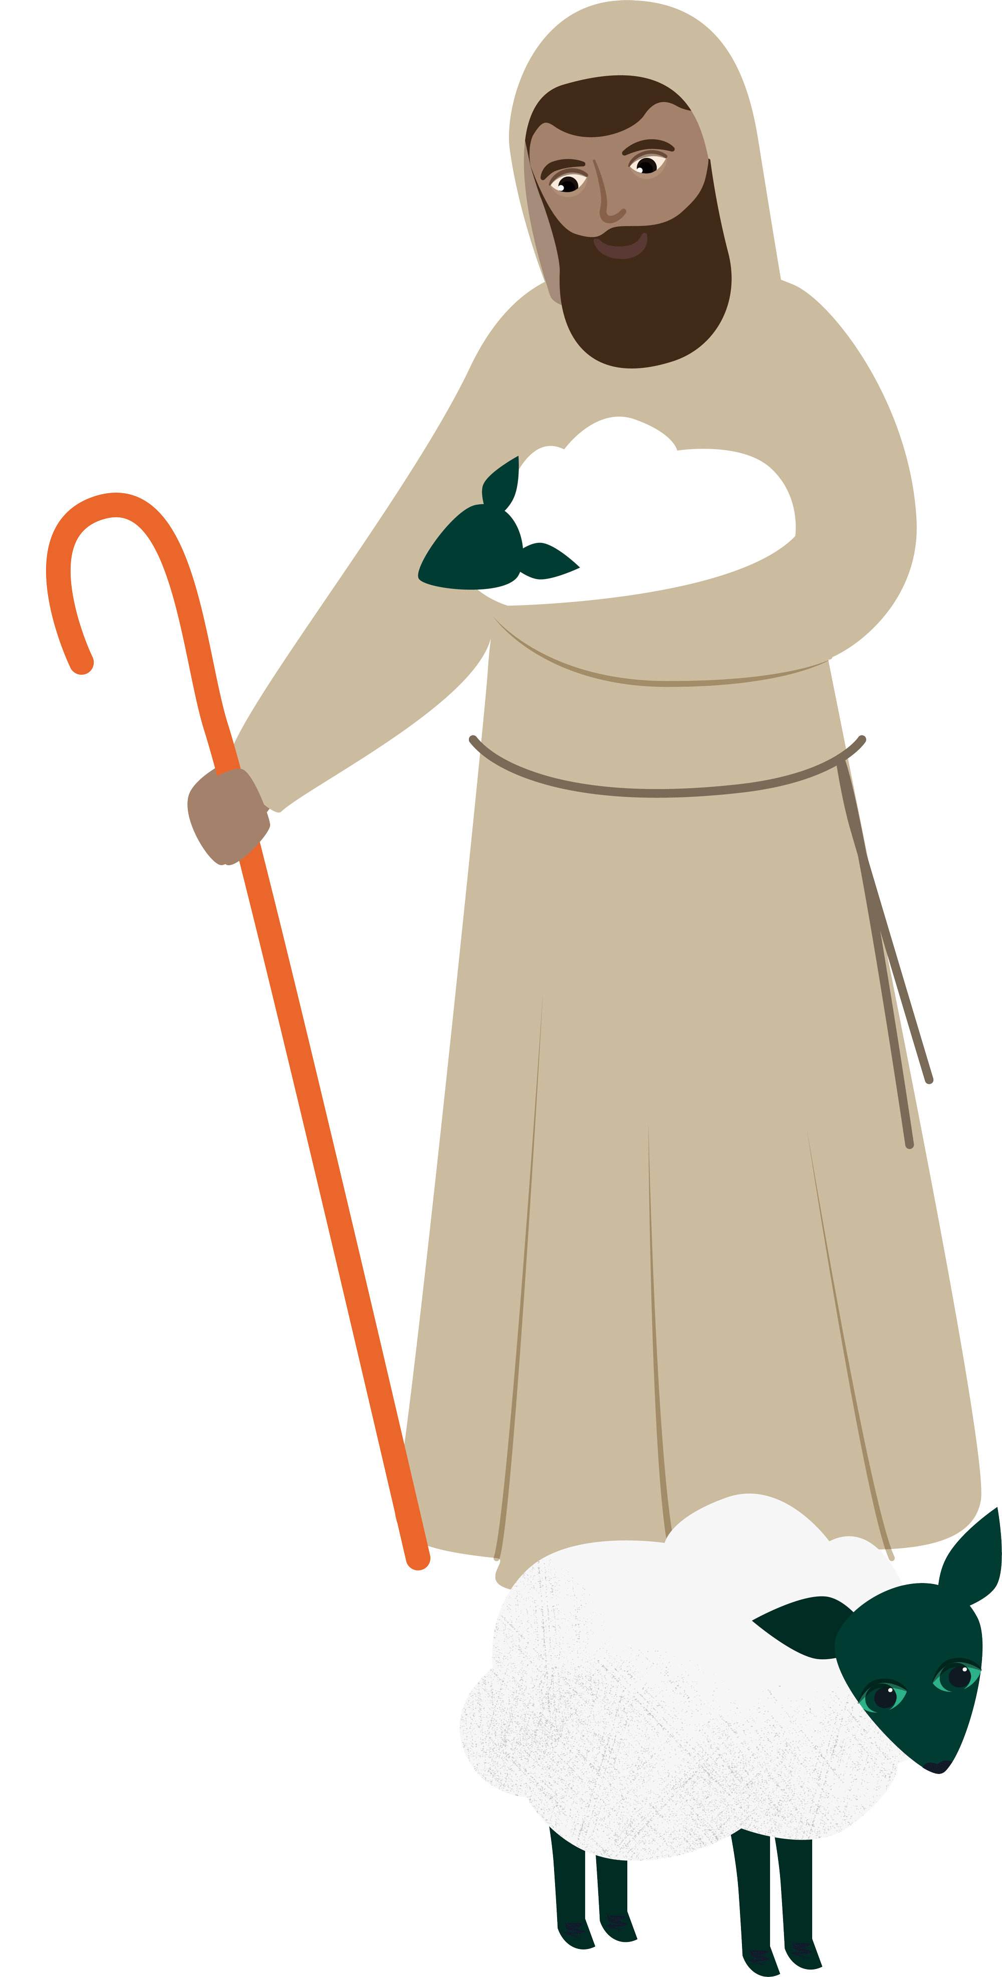
Picture credits: See notes fields of the slides
Illustrator: Sam Osborne

